Slide 1
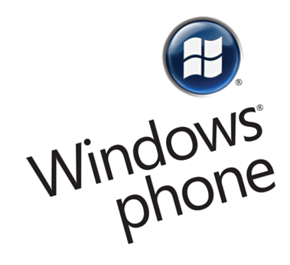
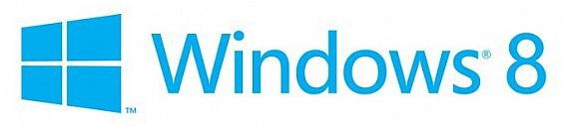

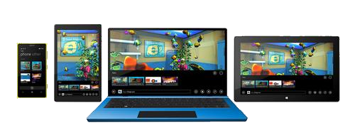
Windows Universal App

Slide 2
Table of Contents
What is Windows Universal?
History
Concepts
Windows Run Time – WinRT
XAML + C#
HTML + JS (WinJS)
Requirements – needed software

Slide 3


History of Windows Universal

Slide 4
History of Windows Universal
2010 – Windows Phone 7
Mid-2011 – public beta of Windows 8
Mid-2012 – publicly released Windows 8
Designed for touch
Microsoft’s OS was headed for the tablet
April 2014 – Windows Universal Apps
Convergence of Windows 8.1 and WP 8.1
Create applications that target the phone and tablet and share a single code base

Slide 5

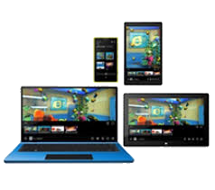
Windows Universal Concepts

Slide 6
Windows Universal Concepts
Develop a universal Windows app that targets Windows and Windows Phone
Share: code, user controls, styles, strings, and other assets between the two projects
Linked files between projects
Conditional compilation with preprocessor directives
#if WINDOWS_APP
//run Windows specific code
#elif WINDOWS_PHONE_APP
//run Windows Phone specific code
#endif

Slide 7
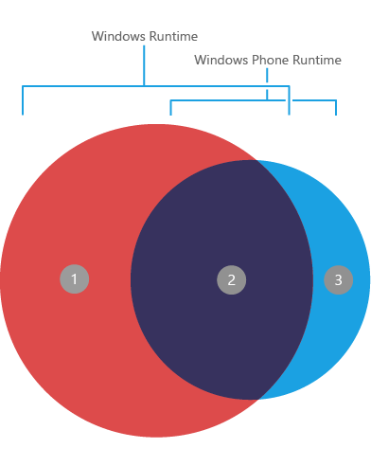
Windows Run Time
a.k.a. WinRT

Slide 8
WinRT
Use XAML + C# or HTML and JS
WinRT APIs (the Windows namespace)
Application model
Activation, suspension, viewStates, etc.
File storage, Application file system access
File & Folder pickers, roaming data, settings, etc.
Contracts, Extensions
Devices
Geolocation, Sensors, Cameras, Speakers, etc.
Networking, Security, Notifications, etc.
Basically gives you access to all Windows 8 APIs

Slide 9
XAML + C#
Descendant of Silverlight
Developing apps using XML-based declarative language
Powerful built-in data and behavior binding
Full set of UI components
Easy-to-learn and adapt
Model-View-ViewModel architecture that is easy to follow

Slide 10
(HTML + JS) WinJS
Use HTML + CSS & JavaScript
Fully-featured JavaScript library
DOM queries
Pages and Navigation
Classes and Namespaces support
+ inheritance, mixing
Promises, XHR requests (AJAX)
Data binding
Controls fitting in the UI model
Animations

Slide 11

Requirements

Slide 12
Requirements
Visual Studio 2013
Visual Studio 2013 Update 2
Blend for Visual Studio
Development tools for Windows Phone apps
Windows Phone Emulator
Developer Registration tool
Application Deployment tool
Get a developer license
Free – renewed every 30 days

Slide 13
Windows Universal App
http://academy.telerik.com

